Slide 1
RISK MANAGEMENT

Slide 2
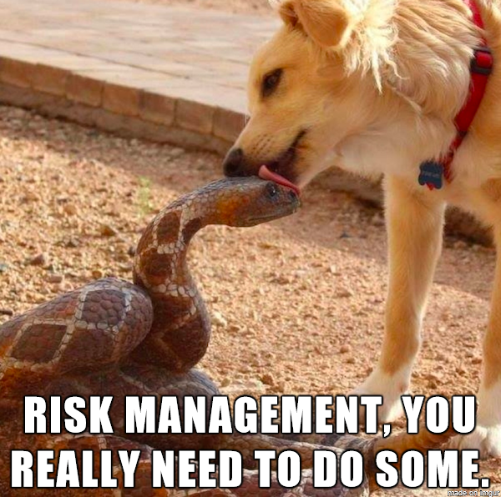
WHAT IS RISK MANAGEMENT?
Risk management is the process of identifying, assessing and controlling financial, legal, strategic and security risks to an organization’s capital and earnings

Slide 3


Slide 4


Slide 5
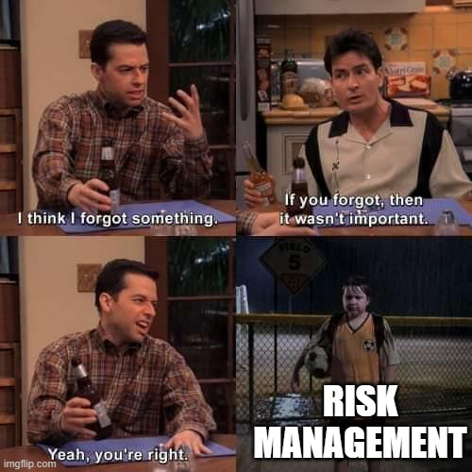
Why risk management is important?
If an unforeseen event catches your organization unaware, the impact could be minor, such as a small impact on your overhead costs. In a worst-case scenario, though, it could be catastrophic and have serious ramifications, such as a significant financial burden or even the closure of your business.

Slide 6
Q: What is the main goal of risk management?

Slide 7

“We don't manage risks so we can have no risk. We manage risks so we know which risks are worth taking, which ones will get us to our goal, which ones have enough of a payout to even take them”

Slide 8
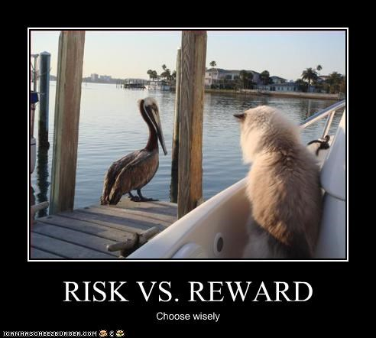

Slide 9
Q: Can you give me some example of Risks in IT project

Slide 10
6 PROJECT RISK EXAMPLES AND HOW TO MANAGE THEM

Slide 11

SCOPE CREEP
Scope risk, or “scope creep”, refers to the unexpected and uncontrolled expansion of a project’s objectives beyond its original intentions. This typically happens when project goals aren’t precisely outlined from the start or when requirements change partway through the project.

Slide 12

How to mitigate scope creep?
Before kicking off a project, it’s essential to solidify and agree upon the objectives, ensuring they are both clear and comprehensive. This foundational step minimizes any potential ambiguities and helps prevent unplanned alterations in the project’s scope.

Slide 13

Performance risks
Performance risk refers to a project’s potential not meeting its predefined success criteria or expectations. It simply means the project does not deliver the anticipated benefits or results despite meeting budgetary and time constraints.

Slide 14

How to mitigate performance risks
Spotting potential performance hazards from the start of a project is vital. This might mean assessing the current market landscape, going deep into users’ needs, and staying ahead of technological shifts.

Slide 15

External hazard risks
External hazard risks refers to unpredictable events stemming from external factors beyond project management’s control. These risks can be natural, such as climatic events, or man-made, like vandalism, terrorism, or societal disruptions.

Slide 16

How to mitigate external hazards risks
While external hazards are unpredictable, proactive steps can lessen their impact. Use historical and political data to regularly assess risks based on the project’s locale and nature.

Slide 17
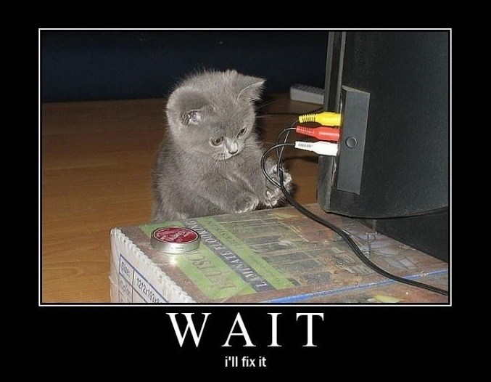
Technology risks
Technology risks cover the potential challenges and threats posed by the integration and dependency on technology within a project. These project risks range from technical failures, cyber-attacks, and system breaches to the fast-paced evolution of technology itself.

Slide 18

How to mitigate technology risks
Ensuring robust cybersecurity measures, including firewalls, encryption, and routine security audits, is vital to fend off cyber threats. It’s also important to have backup systems and data storage to counteract technical issues, preventing data loss or unplanned downtime.

Slide 19
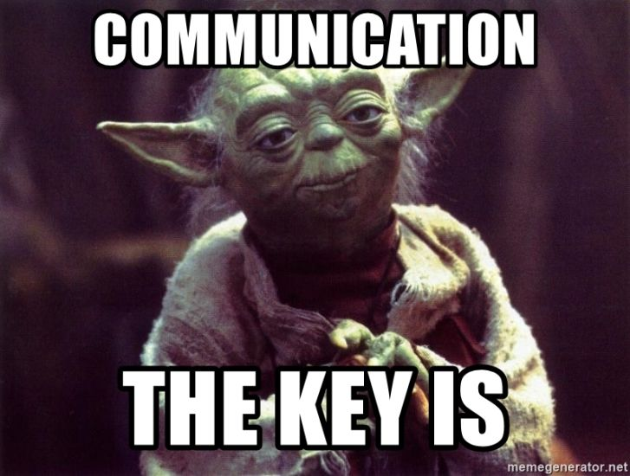
Communication risks
Lack of clarity in a project is a significant risk that arises from miscommunication, ambiguous project scopes, and unclear timelines. This uncertainty can lead to isolated tasks, exceeding budgetary constraints, missing deadlines, shifting project requirements, altering project directions, or ultimately resulting in unsatisfactory outcomes.

Slide 20
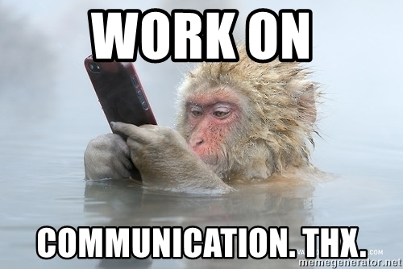
How to mitigate communication risks
Begin with well-defined scopes, objectives, and deadlines to minimize vagueness and align everyone’s expectations. Utilize a central tool or platform to keep everyone on the same page, thus avoiding siloed work.

Slide 21

Cost risks
Cost risk refers to the potential for a project to exceed its allocated budget. This can occur for various reasons, such as poor initial budgeting, scope changes mid-project, unforeseen complications, or inaccuracies in cost estimation.

Slide 22
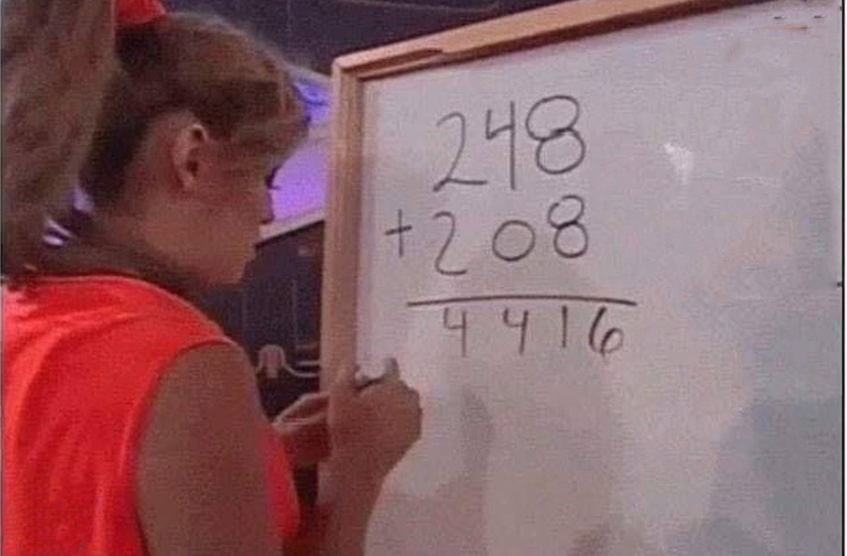
How to mitigate cost risks
Regularly comparing the budget to actual costs is critical, allowing early identification of discrepancies and prompt corrective measures. Project plan templates can align stakeholders on deliverables, scope, and timelines, ensuring collective financial goal alignment.

Slide 23
Types of Risk Management

Slide 24

Risk Acceptance
Acceptance is when an organization decides to accept the risks associated with a particular situation. With this kind of risk management, the company has recognized that it is not worth the cost and effort to mitigate the events that may occur due to the risk.

Slide 25

Risk Transference
Transferring risk is when an organization shifts the risks to another party, such as through insurance. For example, When a person or an organization gets insurance, the financial risk connected with an unfortunate event is transferred to the insurance company instead.

Slide 26

Risk Avoidance
Avoidance of risk is when an organization takes steps to prevent or avoid a particular risk from happening such as an injury, disease, or death. The company mitigates such risks by not involving in risky activities or situations.

Slide 27

Risk reduction and loss prevention
Loss prevention and reduction are when an organization takes steps or methods to reduce the impact of a particular risk that occurs. It combines risk acceptance as it acknowledges the risk involved while also focusing on how to reduce and contain the loss from spreading.

Slide 28

Risk Sharing
Risk sharing is when an organization distributes the risk to the whole team. This method removes the burden of problematic events to one department and shares it with others so that those who can help and provide support for that problem can help and control those risks.

Slide 29
RISK MANAGEMENT LIFECYCLE

Slide 30
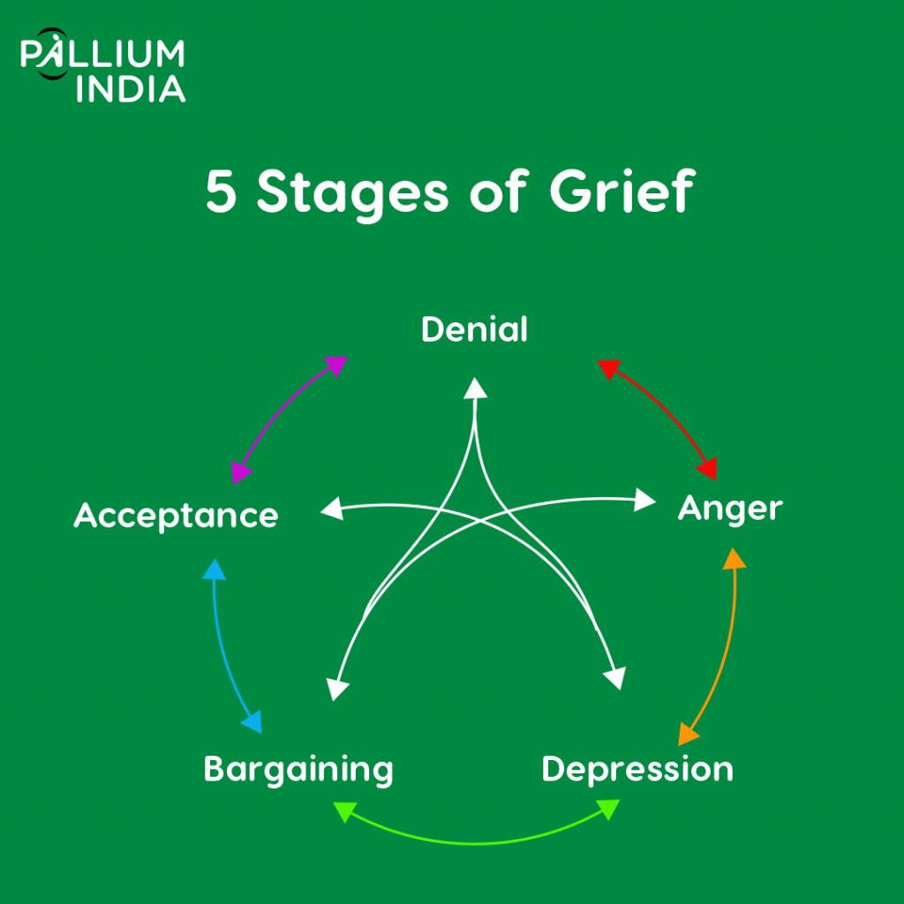

Slide 31
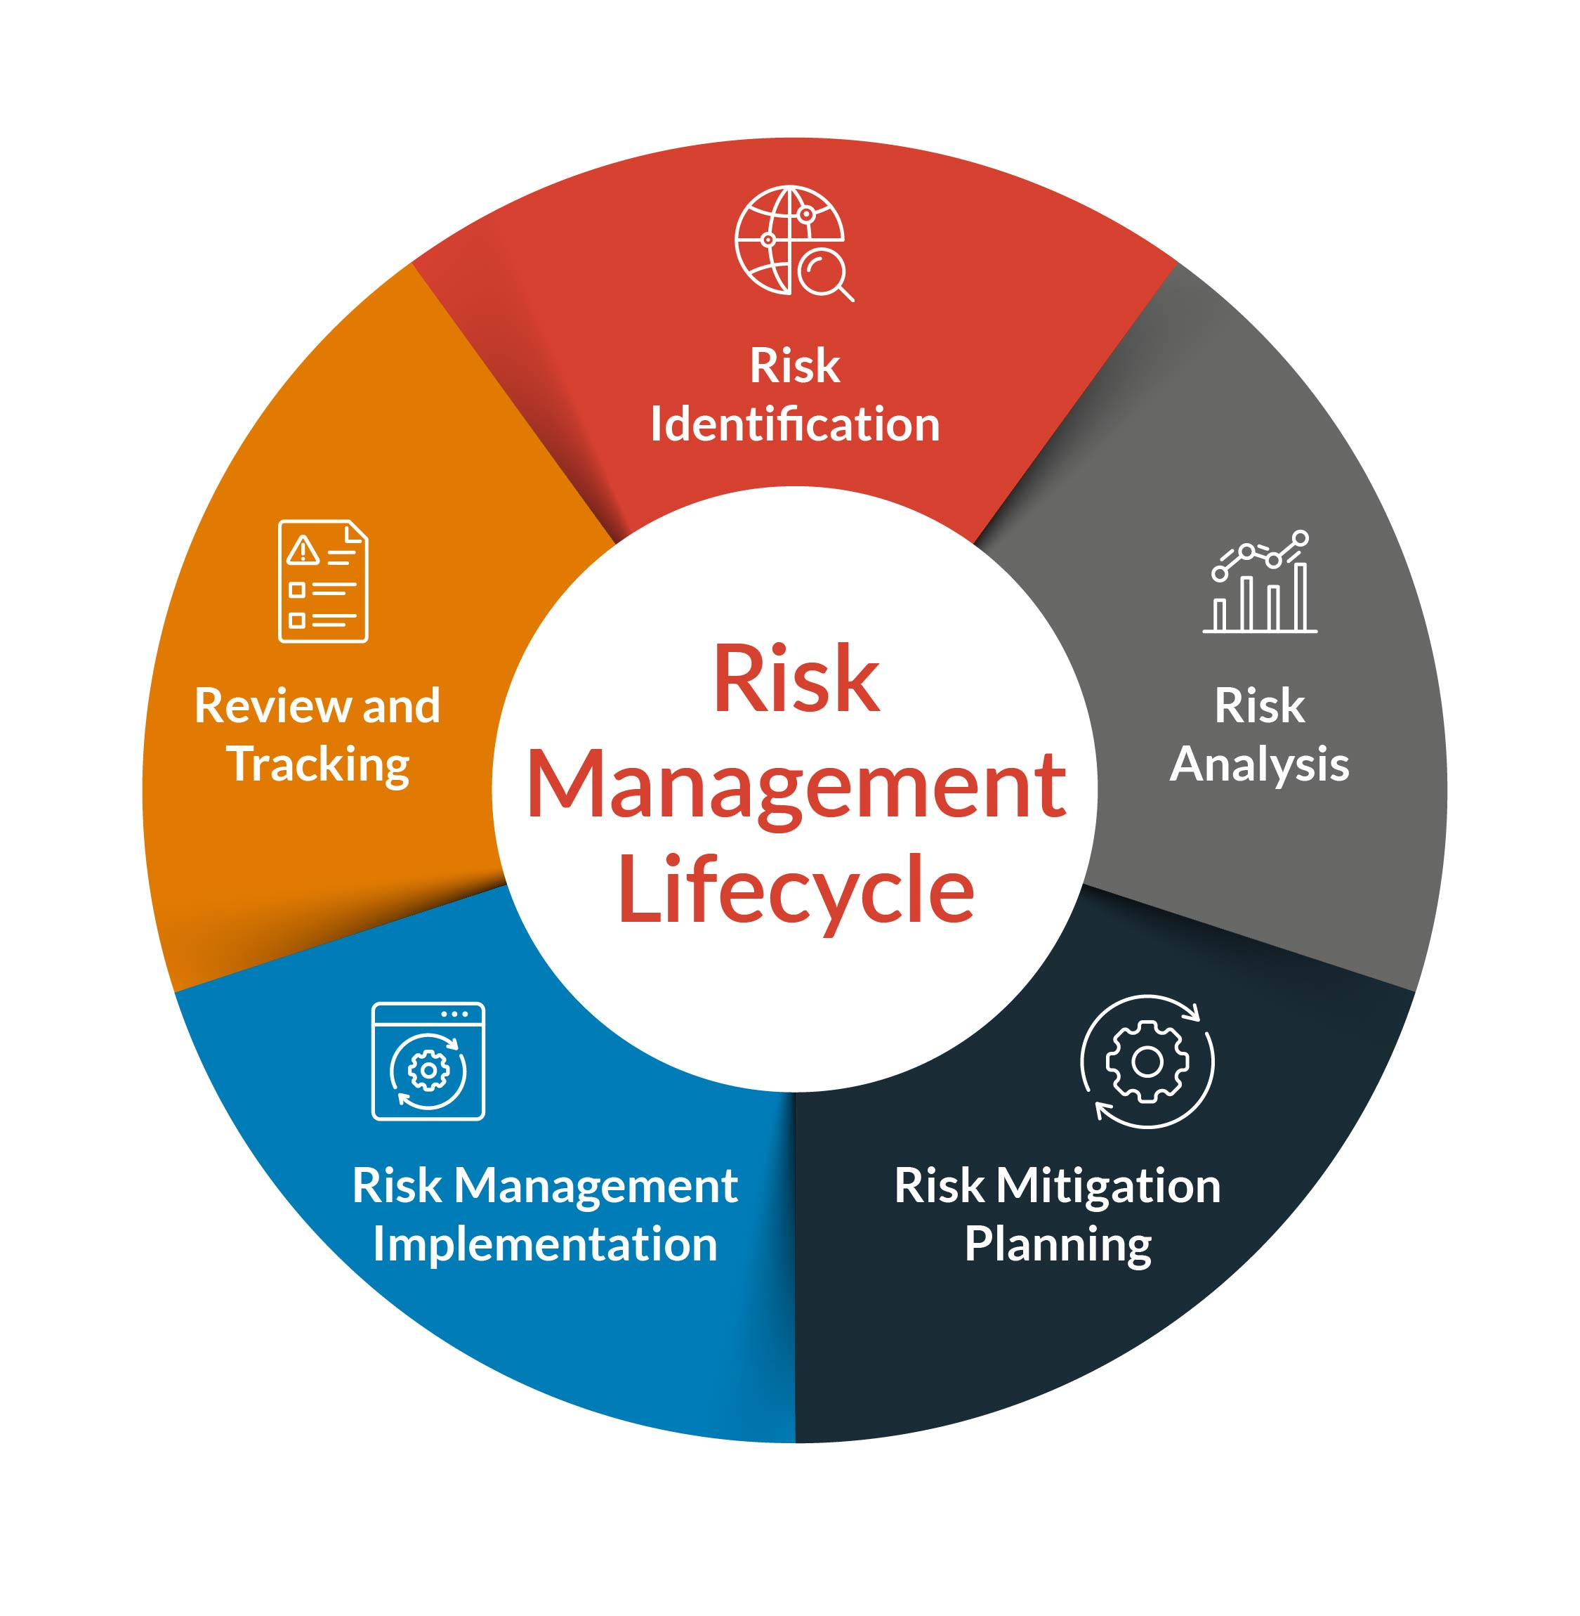

Slide 32

Risk identification
First, you need to take stock of the threats your company faces. The specific risks will depend on your company and business processes, but there are several common classifications:
Operational risks specific to your industry, like the presence of heavy machinery or toxic chemicals
Weather-related risks like hurricanes, winter storms, or flooding
Legal or compliance risks (if you’re in a highly regulated industry)
Financial risks, such as poor cash flow management

Slide 33
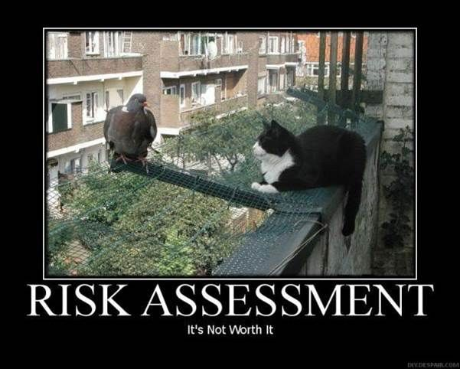
Risk analysis
Next, you’ll analyze your identified risks. There are two key factors to consider for each threat:
How likely is the threat to happen?
What’s the negative impact if the threat occurs?
Risks scoring highly in both categories should be addressed first, followed by less likely and/or lower-impact risks.

Slide 34

Risk mitigation planning
Once you understand the risks you face, you need to decide how to deal with them. Along with likelihood and impact, you need to understand your risk tolerance. If facing a hazard carries a significant reward, you’re more likely to tolerate the risk. But if there’s no reward, there’s no value in taking on the risk.

Slide 35

Risk management implementation
After developing risk management plans, it’s time to implement them. Depending on the threat, there are a variety of risk mitigation strategies to consider:
Exercise risks by practicing for them in scenarios like fire drills
Challenge risks by allowing them to progress until the danger becomes unmanageable
Isolate risks by minimizing potential impact, as is common with firewalls and network architecture in the cybersecurity world
Buffer a risk by using more resources to prevent it, for example, by adding slack time to a schedule or having extra personnel on hand
Make a contingency plan for when your initial risk mitigation strategy falls short of its goal

Slide 36

Risk management review and tracking
Once your process is in motion, you need to monitor the risk to see how the situation unfolds and respond accordingly. Sometimes, this can be quick—and it will be over in a matter of days . Other times, it can be an ongoing process, like monitoring the risk of theft in a retail environment

Slide 37
RISK ASSESSMENT TOOLS

Slide 38
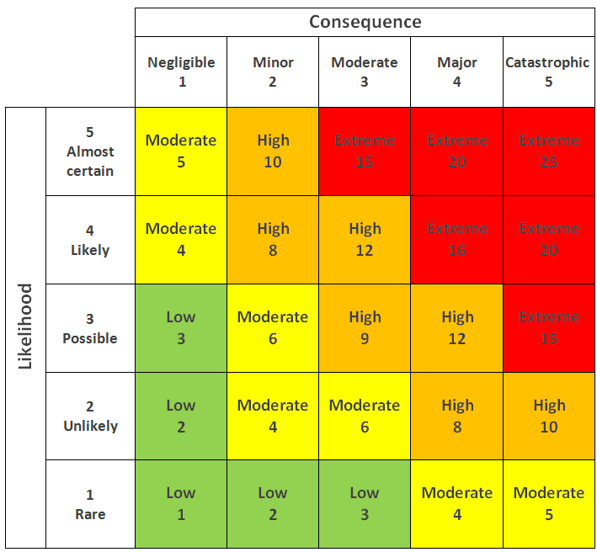
Risk Matrix
Risk is defined as probability multiplied by potential impact. A risk matrix breaks these out into separate scales and assigns numeric values to each level of probability and impact. This allows you to chart the values on a matrix and calculate the risk for each combination of values.

Slide 39
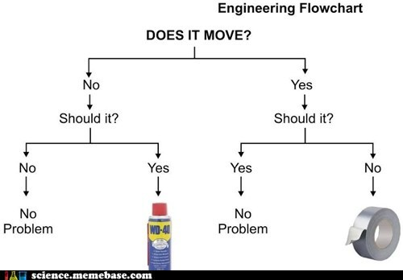
Decision Tree
A decision tree is a less frequently used risk assessment tool, but it can still come in handy. It’s particularly useful for understanding how to apply policies or choosing between different modes of action.
How a Decision Tree Works: A decision tree presents a series of questions or choices that branch out into a variety of outcomes.

Slide 40
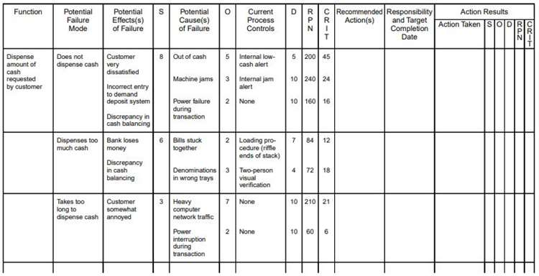
Failure Modes and Effects Analysis
How FMEA Works: an FMEA chart places the process step or design in question on individual rows, with vertical columns allowing you to map out:
Each potential failure and its cause
The effect on higher levels in the process, assembly or system
Existing controls and detection methods
Any required actions and associated details

Slide 41
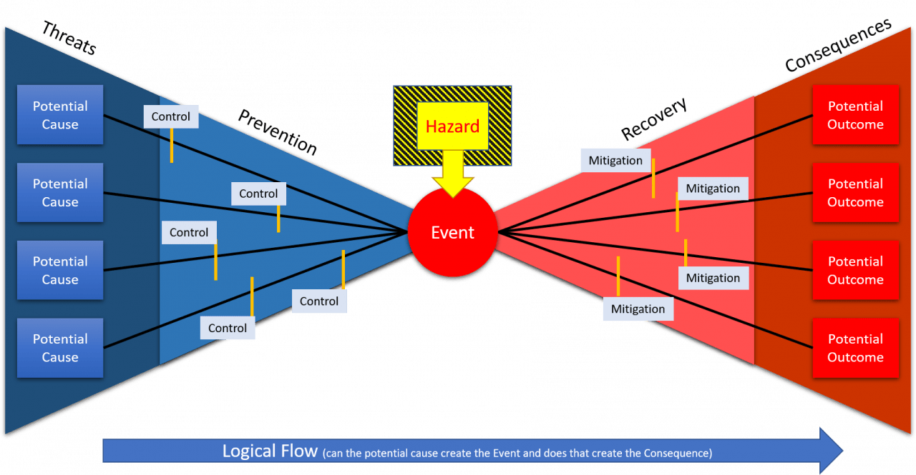
Bowtie Model
The bow tie method is a really visual way of understanding the impacts of a hazard, the risk it presents, the consequences and the controls that should be put in place. On of the benefits of it being so visual is that it's easy to training and easy for anyone to pick up and use so is really great for introducing people to the concept of risk analysis. It looks like this (and you can see why it's called bow tie analysis!)

Slide 42


Slide 43


Slide 44


